Slide 1
GD105 WEEK 10

Slide 2
Functions
"Functions aren't really that important"
-No one ever
Summary: A block of code that you can call from anywhere.
Usage: Simplify and clarify your code.

Slide 3
Functions
-Making a tasty sandwich
void makeSando(){
bread+=2;
lettuce+=1;
sauce+=3;
roastBeef+=27;
placeSandwich(plateX, plateY);
}
Notes:
Here, clarify that these are all variables being changed, but mention functions can do anything, not just change variables.

Slide 4
Functions taking an argument
-Now, makeSando will take an "argument" or parameter.
void makeSando (int numSandos) {
bread+=2 * numSandos;
lettuce+=1 * numSandos;
sauce+=3 * numSandos;
roastBeef+=27 * numSandos;
judgement=false;
}
Calling "makeSando(10);" will make 10 sandwiches.
Notes:
Assert the importance and relevance of the aforementioned scope of variables.

Slide 5
Save function
Extra fun:
line(20, 20, 80, 80);
// Saves a TIFF file named "diagonal.tif"
save("diagonal.tif");
// Saves a TARGA file named "cross.tga"
line(80, 20, 20, 80);
save("cross.tga");
noLoop(); // don't want to save 60 images a second

Slide 6
Matrix Transformations
Translate, Rotate, Scale

Slide 7
TLO – Top-Left Origin
(0, 0)

Slide 8
Move Origin to Center
(0, 0)
translate(width/2, height/2);

Slide 9
Move Origin to Center
(0, 0)
translate(width/2, height/2);

Slide 10
Move Origin to Center
rectMode(CENTER);
rect(0, 0, 100, 100);

Slide 11
“Why not just draw a rect() at
(width/2, height/2) ?”

Slide 12
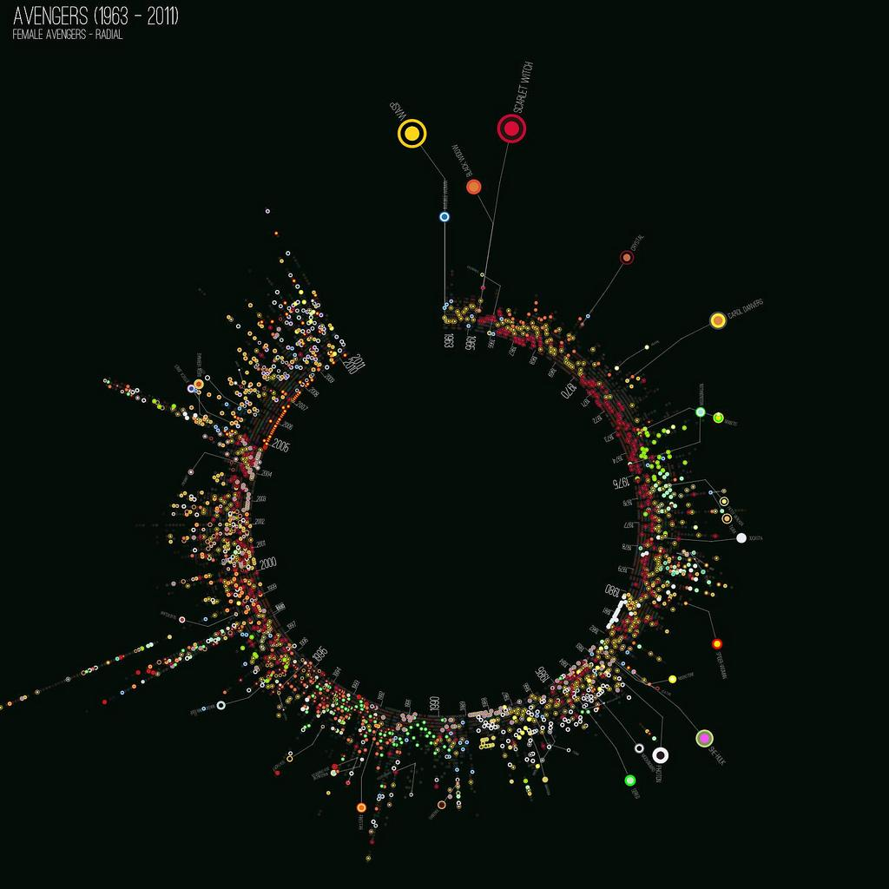
Jer Thorp, “Avengers, Assembled and Visualized”

Slide 13
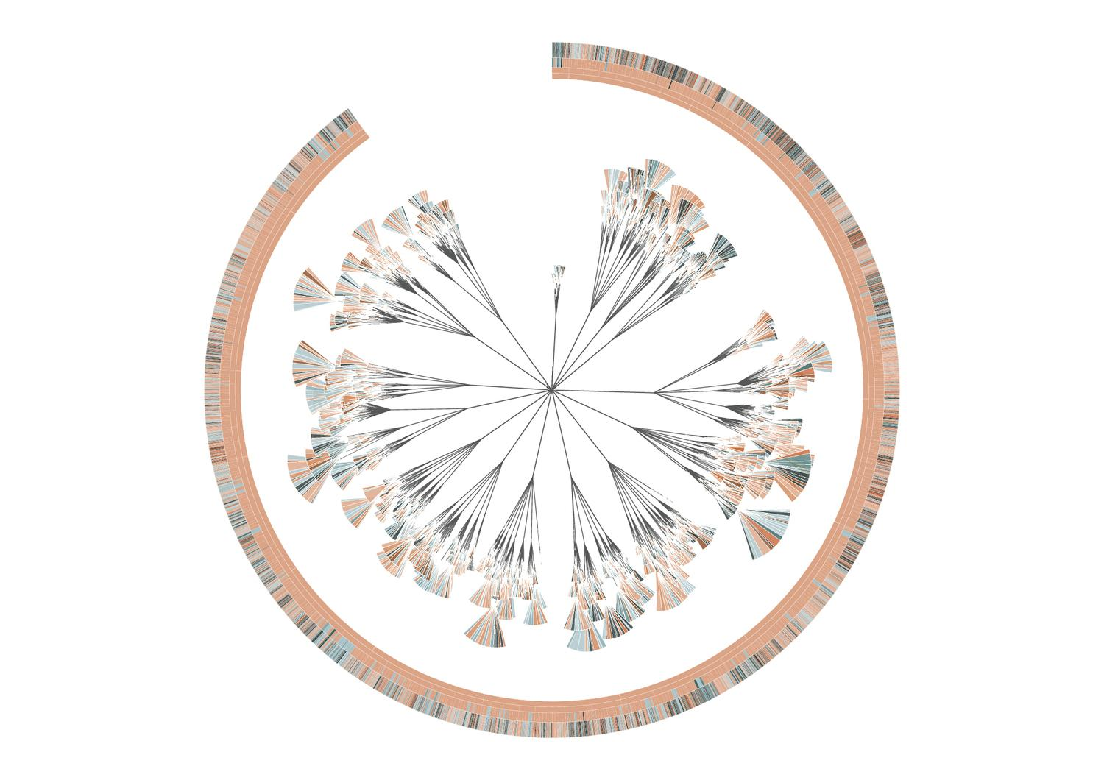
Stefanie Posavec, “(En)tangled Word Bank”

Slide 14
Rotate around top left
(0, 0)

Slide 15
Rotate around middle
(0, 0)
translate(width/2, height/2);

Slide 16
pushMatrix() / popMatrix()
isolate translations and rotations

Slide 17
Let’s Code!

Slide 18
GD105 Fall 17 Grade Breakdown

Slide 19
GD105 Fall 17
Grade Breakdown
A: 4
B: 6
C: 3
D: 7
F: 9

Slide 20
CLEMENCY WEEK

Slide 21
CLEMENCY WEEK
THIS WEEK ONLY, late assignments will be allowed to be turned in for 60% credit. They must be submitted, clearly labeled with a description, your name, well-commented with proper citations and submitted to the “Late Assignments” OP collection in order to receive 60% credit. After this week, the zeros for assignments will be finalized.

Slide 22
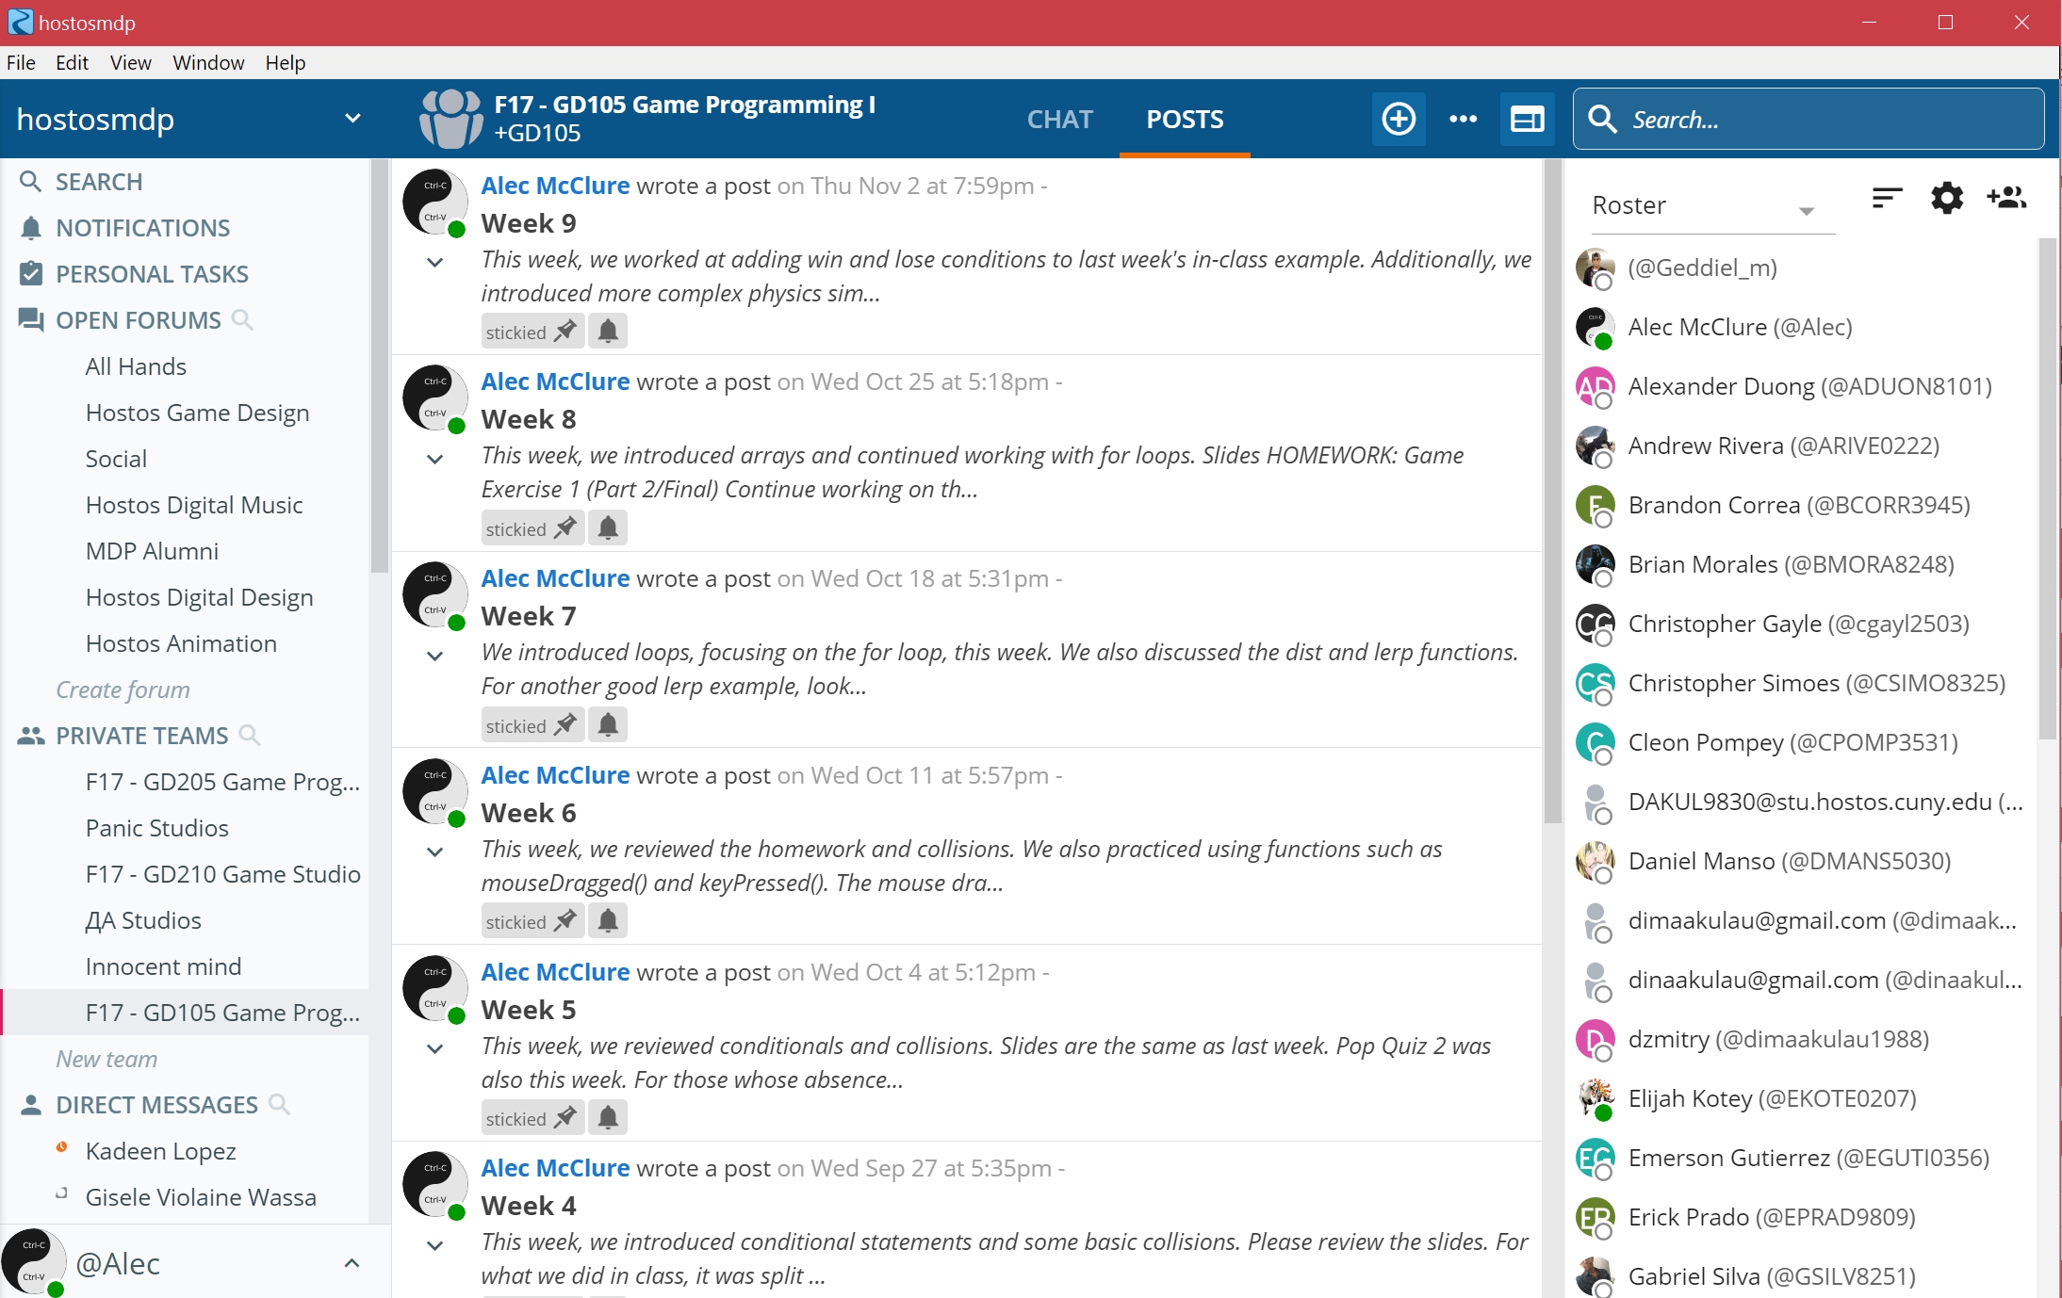
EXTRA CREDIT
Submitting

Slide 23
EXTRA CREDIT
MUST INCLUDE: Photos from the event; a written reportback detailing how the event was. Was it worthwhile? Did you learn anything? Meet anyone? etc.

Slide 24
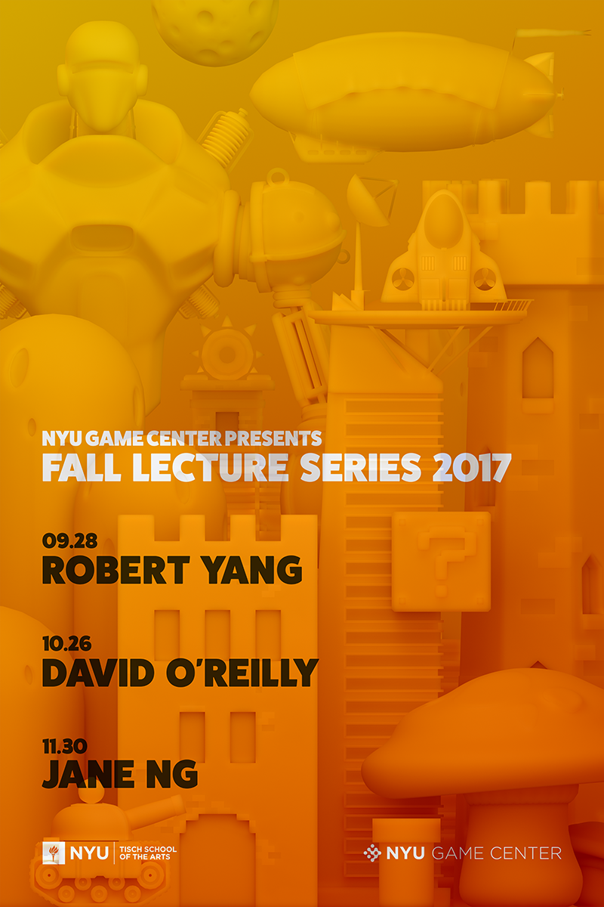

EXTRA CREDIT
Upcoming Opportunities

Slide 25
Write childhood dream profession and an unusual animal on the board with your name.

Slide 26
WHAT IS A LIBRARY?
A library is a collection of “helper” code.
It might consist of functions, variables, and objects.
We can use them to make our lives easier in accomplishing our programming goals.

Slide 27
HOW DO YOU USE THEM?
Import!
(That’s it)
(As long as the library itself is in the right folder in your Processing directory)

Slide 28
PS: We’ve already been using them.
Whenever we call a function like line(), background(), ellipse(), whatever - we are calling a function that is inside the CORE PROCESSING LIBRARY.
import processing.core.*;
(this is implicit in every Processing sketch!)

Slide 29
Let’s install and try:
Minim
ControlP5
Video (don’t need to download anything for this one)
pBox2D

Slide 30
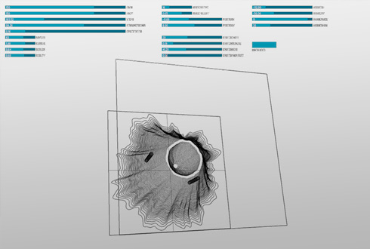
ControlP5

Slide 31
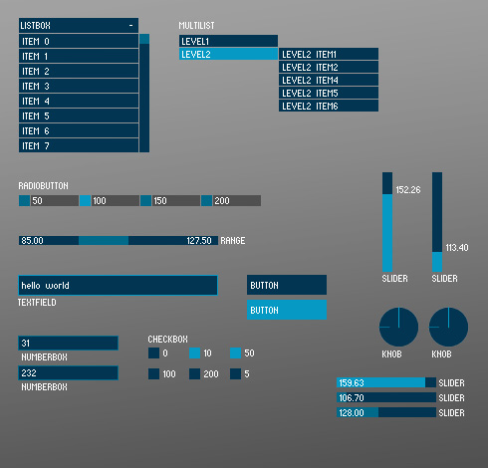
ControlP5

Slide 32
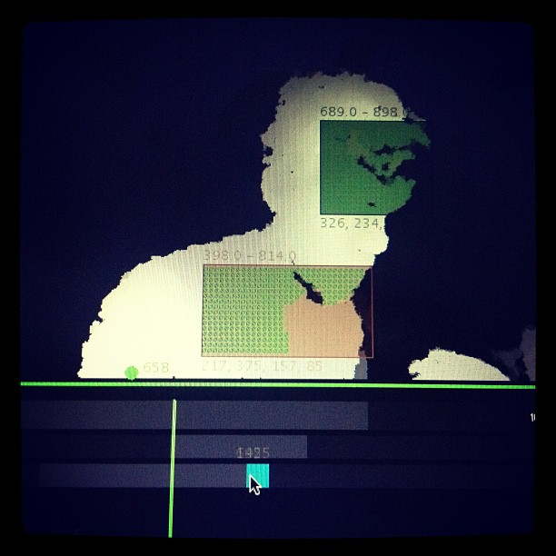
ControlP5

Slide 33
FINAL PROJECT
Formal presentations will occur next week. Bring in at least one functioning prototype and 3 examples of projects that have had similar functionality or themes. What are the mechanics you will need to code? Which libraries will you use?
Your theme is based on what you wrote on the board.

